Slide 1
Chapter 6
TCP/IP Model

Slide 2
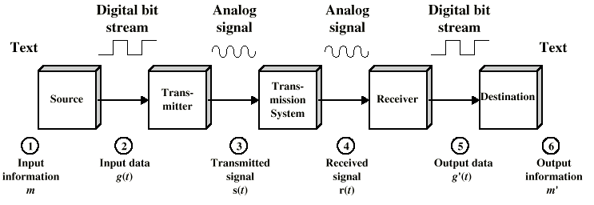
Data Communications Model

Slide 3
Components of a data communications system
l. Message The message is the information (data) to be communicated.
Popular forms of information include text, numbers, pictures, audio,
and video.
2. Sender The sender is the device that sends the data message.
It can be a computer, workstation, telephone handset, video camera.
3. Receiver The receiver is the device that receives the message.
It can be a computer, workstation, telephone handset, television.
4. Transmission medium The transmission medium is the physical path
by which a message travels from sender to receiver.
Some examples of transmission media include twisted-pair wire,
coaxial cable, fiber-optic cable, and radio waves.
5. Protocol A protocol is a set of rules that govern data communications.
It represents an agreement between the communicating devices.
Without a protocol, two devices may be connected but not
communicating, just as a person speaking French cannot be understood
by a person who speaks only Japanese

Slide 4
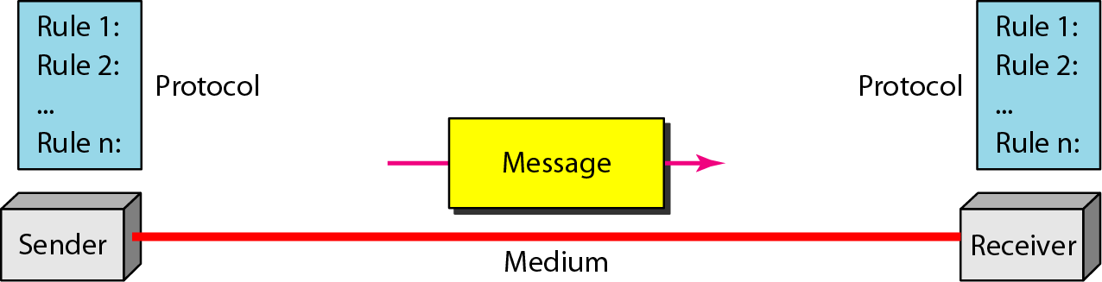
Figure : Components of a data communication system

Slide 5
Four fundamental characteristics
Four fundamental characteristics of data communication: delivery, accuracy, timeliness, and jitter.
I. Delivery. The system must deliver data to the correct destination. Data must be received by the intended device or user and only by that device or user.
2. Accuracy. The system must deliver the data accurately. Data that have been
altered in transmission and left uncorrected are unusable.
3. Timeliness. The system must deliver data in a timely manner. Data delivered late are useless. In the case of video and audio, timely delivery means delivering data as they are produced, in the same order that they are produced, and without significant delay. This kind of delivery is called real-time transmission.
4. Jitter. Jitter refers to the variation in the packet arrival time. It is the uneven delay in the delivery of audio or video packets.

Slide 6
TCP/IP Model
Much older than OSI model
Consists of 4 layers instead of 7
TCP/IP model can be mapped to the OSI model

Slide 7
TCP/IP vs OSI
TCP/IP | OSI
Application | Application Presentation Session (Layers 7-5)
Transport | Transport (Layer 4)
Internet | Network (Layer 3)
Network Interface | Data Link Physical (Layers 1-2)

Slide 8
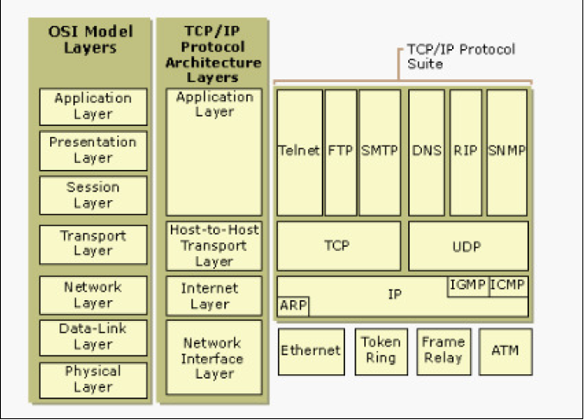

Slide 9
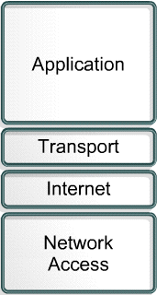
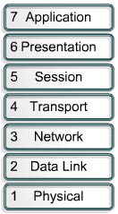
TCP/IP Vs OSI
TCT/IP
OSI

Slide 10
Network Structure
UDP: User Datagram Protocol:
ICMP: Internet Control
Message Protocol
IP: Internet Protocol
ARP: Address Resolution
Protocol
RARP: Reverse ARP
user
processor
user
processor
OSI Layer 5-7
TCP
UDP
OSI Layer 4
ICMP
IP
ARP
RARP
OSI Layer 3
hardware
interface
OSI Layer 1-2

Slide 11
Hierarchical Addressing Scheme
Connection defines the communication link between two processes
UDP = User Datagram Protocol
16-bit UDP source port #
16-bit UDP dest. port #
data
protocol = UDP
internet 32-bit source addr
internet 32-bit dest. addr
UDP
header
data
IP
header
UDP
header
data
frame type = IP
Ethernet 48-bit source addr
Ethernet 48-bit dest. addr
Ethernet
header
IP
header
UDP
header
data
Ethernet
trailer
Ethernet frame

Slide 12
TCP/IP is a hierarchical protocol made up of interactive modules, each of which provides a specific functionality; however, the modules are not necessarily interdependent.
Whereas the OSI model specifies which functions belong to each of its layers, the layers of the TCP/IP protocol suite contain relatively independent protocols that can be mixed and matched depending on the needs of the system.
The term hierarchical means that each upper-level protocol is supported by one or more lower-level protocols.

Slide 13
Physical and Data Link Layers
At the physical and data link layers, TCP/IP does not define any specific protocol.
It supports all the standard and proprietary protocols.
A network in a TCP/IP internetwork can be a local-area network or a wide-area network.

Slide 14
Network Layer
At the network layer (or, more accurately, the internetwork layer), TCP/IP supports the Internetworking Protocol.
IP, in turn, uses four supporting protocols:
ARP,RARP, ICMP, and IGMP

Slide 15
Internetworking Protocol (IP)
The Internetworking Protocol (IP) is the transmission mechanism used by the TCP/IP protocols.
It is an unreliable and connectionless protocol-a best-effort delivery service.
The term best effort means that IP provides no error checking or tracking.
IP assumes the unreliability of the underlying layers and does its best to get a transmission through to its destination, but with no guarantees.
IP transports data in packets called datagrams, each of which is transported separately.
Datagrams can travel along different routes and can arrive out of sequence or be duplicated.
IP does not keep track of the routes and has no facility for reordering datagrams once they arrive at their destination.

Slide 16
IP
Widely supported network layer protocol for the internet.
IP is one the protocols in the TCP/IP protocol suite.
IP is an unreliable and connectionless protocol.
It defines and routes datagrams across the internet and provides connectionless service. This means that each datagram is handled independently and each datagram can follow different route to the destination. This implies the datagrams sent by the same source to the same destination could arrive out of order. Also some could be lost or corrupted during transmission. Again IP, relies on a higher level protocols to take care of all these problems.
IP protocol uses packet switching and makes best effort to deliver its packets.
By best effort we mean that there is no error and flow control

Slide 17
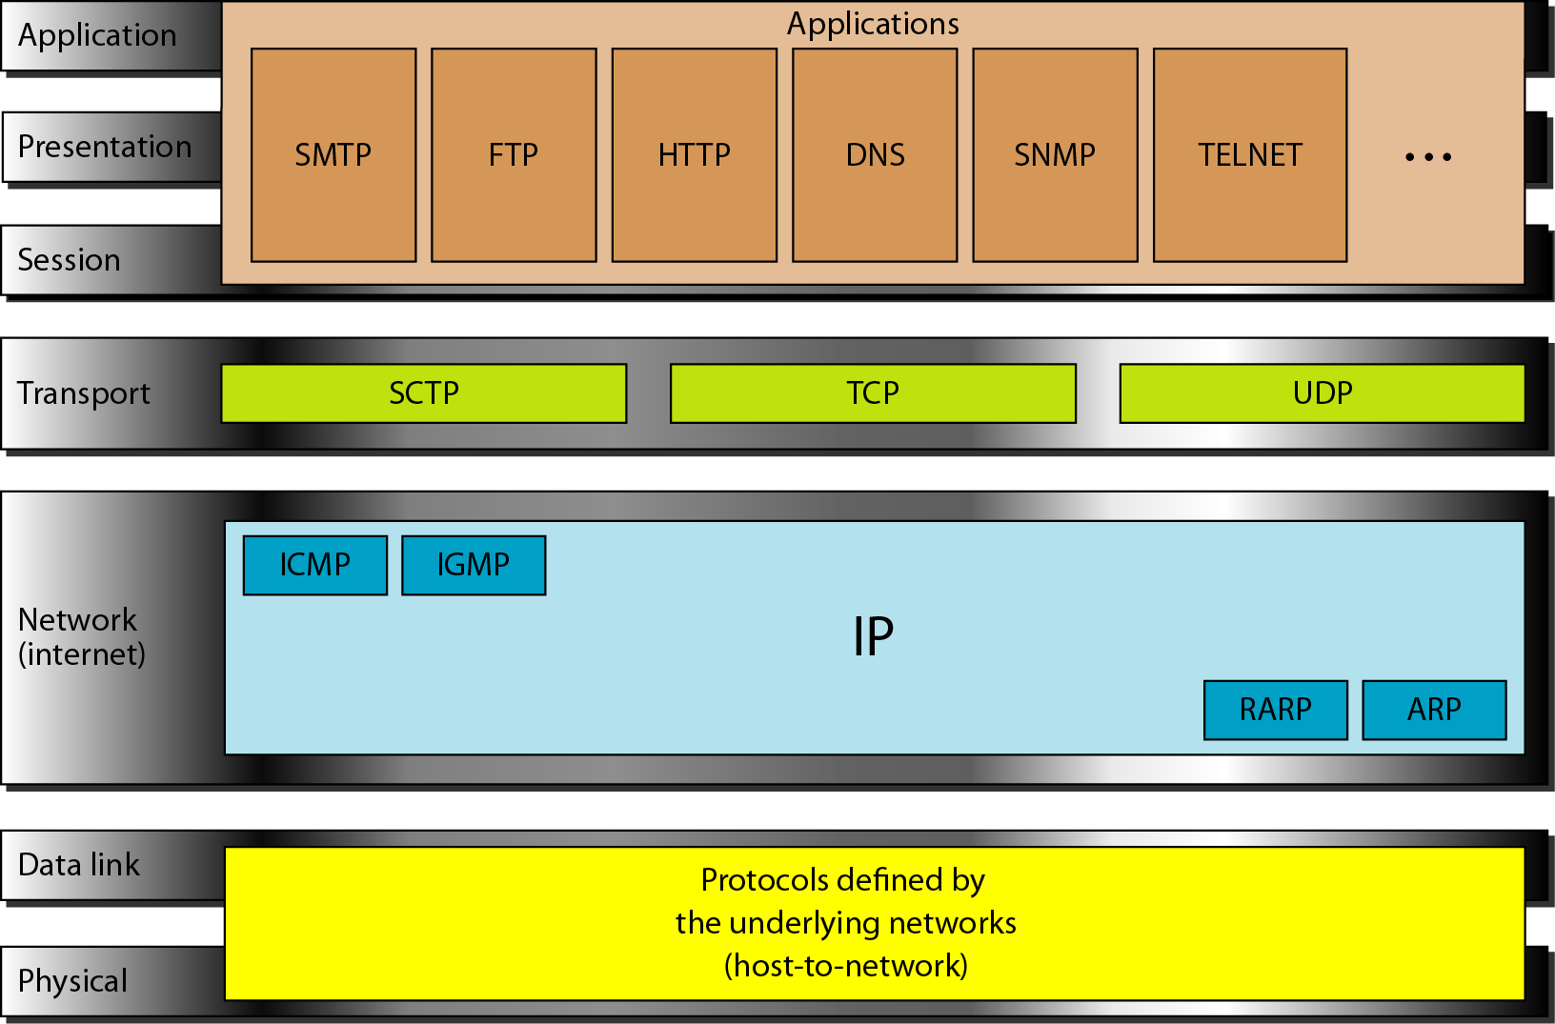
IP

Slide 18
IP
IP performs error detection and discards a packet, if it is corrupted.
To achieve reliability, it is necessary to combine it with a reliable protocol such as TCP.
Packets in IP layer are called datagrams.
The IP header provides information about various functions the IP performs.

Slide 19
Internet Layer Overview
Internet Protocol (IP)
Internet Control Message
Protocol (ICMP)
Address Resolution
Protocol (ARP)
Reverse Address
Resolution Protocol (RARP)
Application
Transport
Internet
Data-Link
Physical
In the OSI reference model, the network layer corresponds to the TCP/IP Internet layer.
Notes:
IP is the main protocol
It is connection less
IP will carry the data packets
Data packets are IP Packets
IP

Slide 20
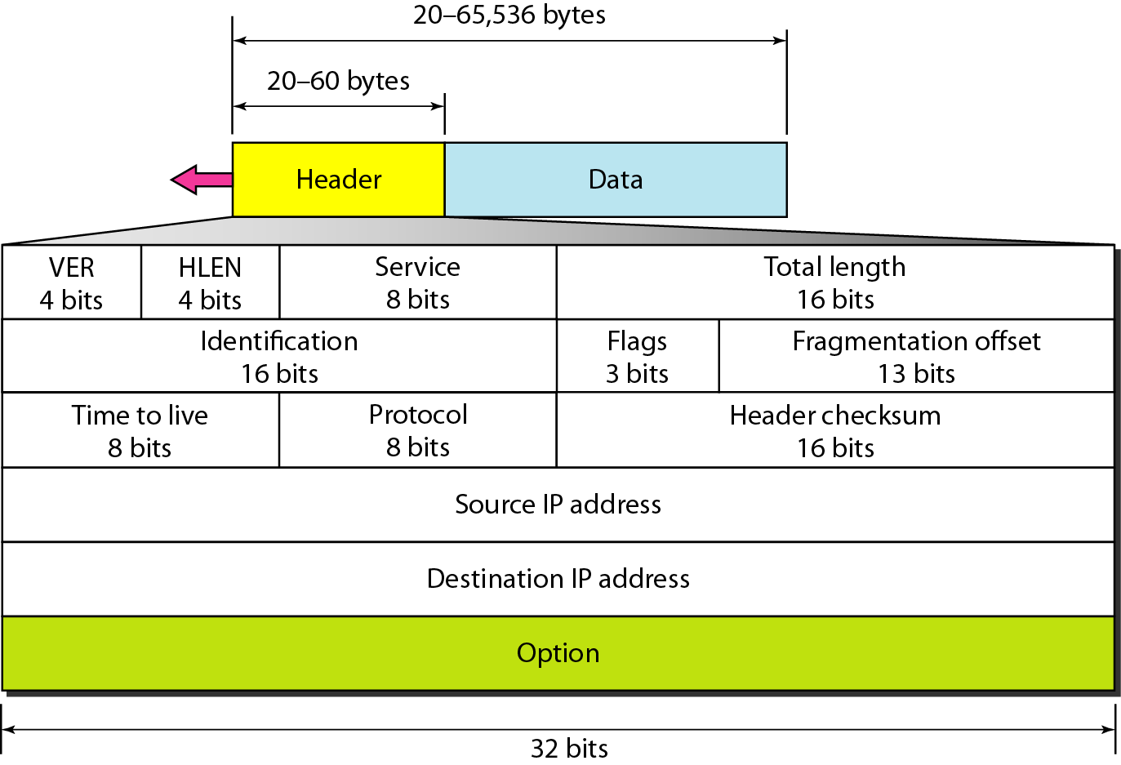
Figure IPv4 datagram format

Slide 21
IP Packet Format
A datagram is a variable-length packet consisting of two parts: header and data.
The header is 20 to 60 bytes in length and contains information essential to routing and delivery.
VER: 4 bit field defines the version of the IP protocol. Currently the version is 4
HLEN: This 4-bit field defines the total length of the datagram header in 4-byte words. This field is needed because the length of the header is variable (between 20 and 60 bytes). When there are no options, the header length is 20 bytes, and the value of this field is 5 (5 x 4 = 20). When the option field is at its maximum size, the value of this field is 15 (15 x 4 = 60).

Slide 22
IP Packet Format
Service type:
now called differentiated services.
8 bit field
Allow packets to be assigned a priority
Router can use this field to route packets
Not universally used

Slide 23
IP packet format
Total length (16 bits): length in bytes of the datagram including headers. Maximum datagram size is (2^16) 65536 bytes.
Time to Live (8 bits): Prevents a packet from traveling forever in a loop. Senders sets a value, that is decremented at each hop. If it reaches zero, packet is discarded.
Protocol: Defines the higher level protocol that uses the service of the IP layer. An IPv4 datagram can encapsulate data from several higher-level protocols such as TCP, UDP, ICMP, and IGMP. This field specifies the final destination protocol to which the IPv4 datagram is delivered.
Identification, Flags, Fragment Offs et: Used for handling fragmentation.

Slide 24
Protocol
8-bit length
It defines the higher level protocol that uses the services of the IPv4 Layer.
It defines the higher level protocol to which the IPv4 datagram is delivered.

Slide 25
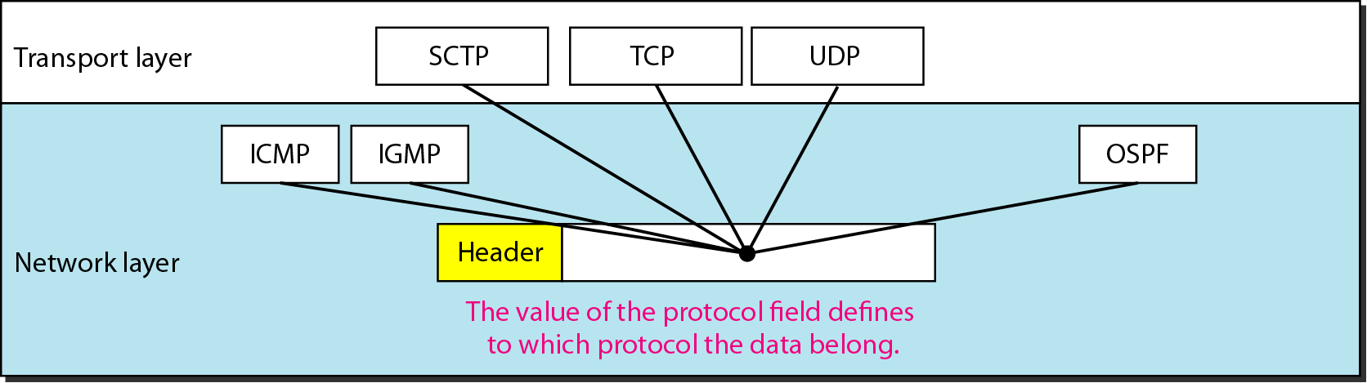
Figure Protocol field and encapsulated data

Slide 26
Table protocol values

Slide 27
Example 1
An IPv4 packet has arrived with the first 8 bits as shown:
01000010
The receiver discards the packet. Why?
Solution
There is an error in this packet. The 4 leftmost bits (0100) show the version, which is correct. The next 4 bits (0010) show an invalid header length (2 × 4 = 8). The minimum number of bytes in the header must be 20. The packet has been corrupted in transmission.

Slide 28
Example 2
In an IPv4 packet, the value of HLEN is 1000 in binary. How many bytes of options are being carried by this packet?
Solution
The HLEN value is 8, which means the total number of bytes in the header is 8 × 4, or 32 bytes. The first 20 bytes are the base header, the next 12 bytes are the options.

Slide 29
Continues..
Source IP address (32 bits): Internet address of the sender.
Destination IP address (32 bits): Internet address of the destination.
Checksum: the checksum in the IP packet covers only the header, not the data. All higher level protocols that encapsulate data in the IP datagram have a checksum field that covers the whole packet. So checksum for IP datagram doesn’t have to check the encapsulated data. Second, the header of IP packet changes with each visited router, but the data don’t.
Options, as the name implies, are not required for a datagram. They can be used for network testing and debugging.

Slide 30
Fragmentation
Why Fragmentation is Required?
A datagram can travel through different networks whose Protocols are defined by the data link and Physical Layer.
We know that at the data link layer we deal with Frames.
For different network Protocols at data link layer we have different formats and sizes of frames.
Now we also know that the Packet from network layer called datagram (Header + data) act completely as data for the data link Frame.

Slide 31
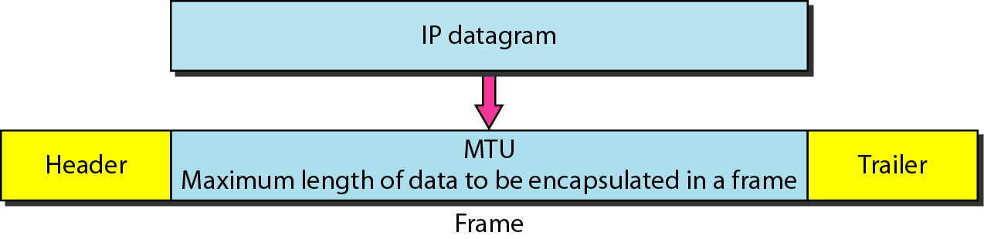
Figure Maximum transfer unit (MTU)

Slide 32
Continued
Different Data link layer Protocols e.g. X.25, Frame Relay, Ethernet etc have different frame formats in which there is a field that limits the size of the Data in the frame called Maximum Transfer Unit.
Thus in many cases (datagram traveling from LAN to WAN) it is required to fragment the datagram according to the MTU of the underlying network.

Slide 33
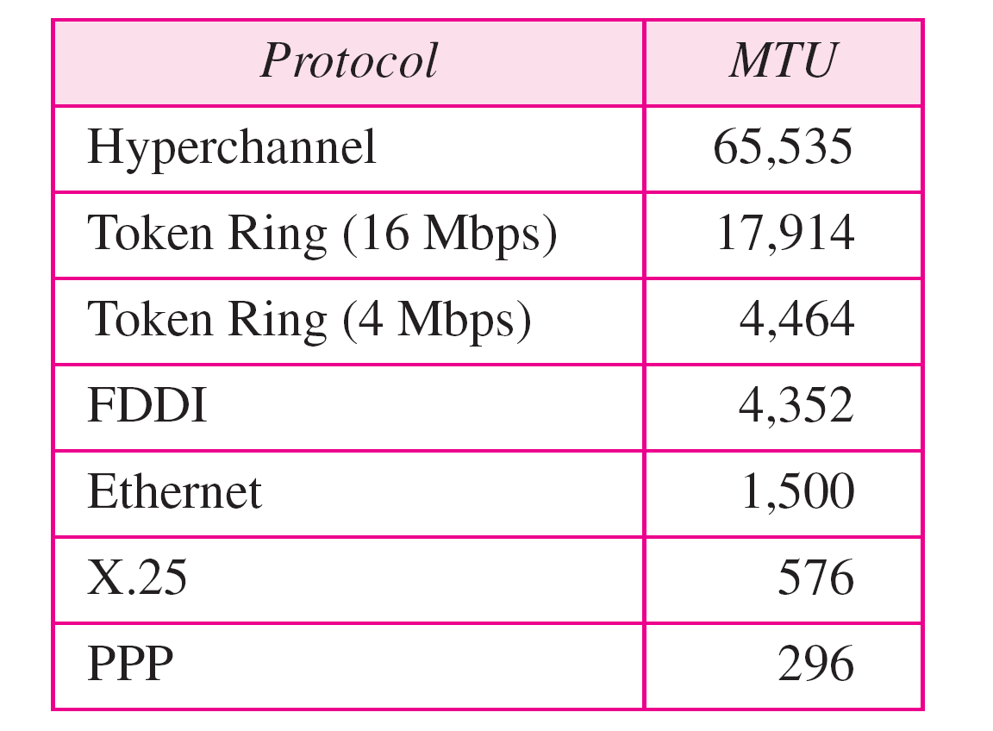
Table MTUs for some networks

Slide 34
Fields Related To Fragmentation
Identification
16-bit field
Each datagram is assigned a unique number
When the datagram is fragmented the same identification number is copied to all the fragments.
Flags
3 bit field
1st bit is reserved

Slide 35
Continued…..
2nd bit is Do not Fragment
if the value of this field is 1 the machine must not fragment the datagram. If it cannot pass the datagram though any available physical network, it discards the datagram and sends and ICMP error message to the source host.
If the value is 0, this means that whenever required the datagram can be fragmented according to the requirement of the physical network it is travelling.
3rd bit is More Fragment
If its value is 1, it means this is not the last fragment more fragments have to come.
If its value is 0, it means this is the last fragment or the only fragment.

Slide 36

Figure Flags used in fragmentation

Slide 37
Continued…..
Fragmentation Offset
13 bit Field
Shows the relative position of the fragment in the whole datagram.
Offset is measured in units of 8 bytes.

Slide 38
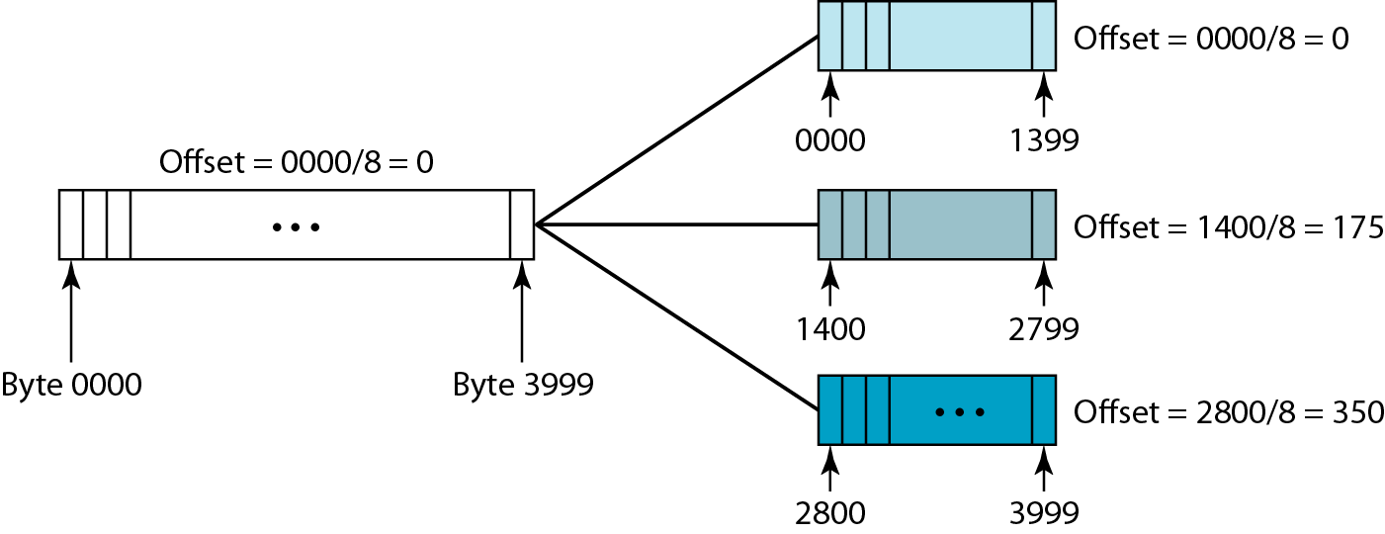
Figure Fragmentation example

Slide 39
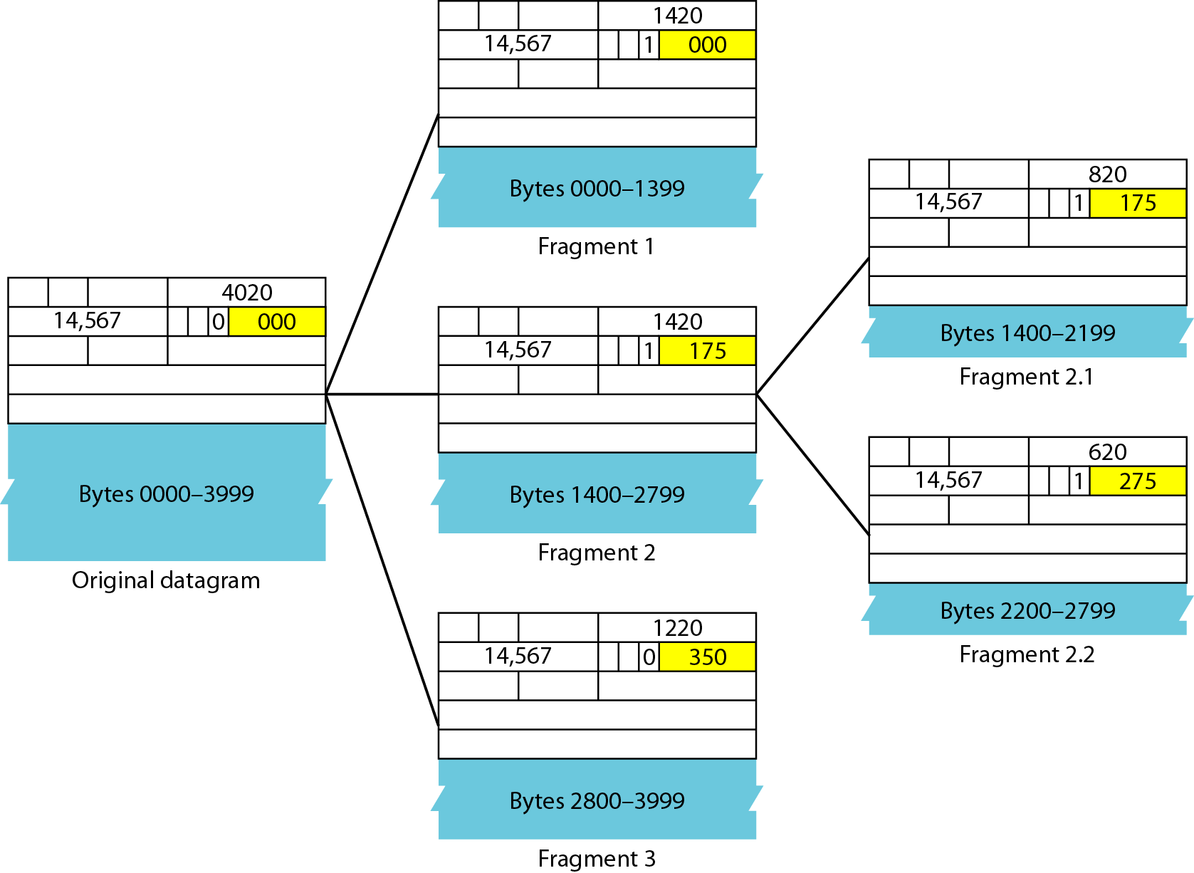
Figure Detailed fragmentation example

Slide 40
It is obvious that even if each fragment follows a different path and arrives out of order, the final destination host can reassemble the original datagram from the fragments received (if none of them is lost) using the following strategy:
a. The first fragment has an offset field value of zero.
b. Divide the length of the first fragment by 8. The second fragment has an offset value equal to that result.
c. Divide the total length of the first and second fragment by 8. The third fragment has an offset value equal to that result.
d. Continue the process. The last fragment has its M bit set to 0.
e. Continue the process. The last fragment has a more bit value of 0.

Slide 41
Example 1. A packet has arrived with an M bit value of 0. Is this the first fragment, the last fragment, or a middle fragment? Do we know if the packet was fragmented?
Solution
If the M bit is 0, it means that there are no more fragments; the fragment is the last one. However, we cannot say if the original packet was fragmented or not. A nonfragmented packet is considered the last fragment.

Slide 42
Example 2. A packet has arrived with an M bit value of 1. Is this the first fragment, the last fragment, or a middle fragment? Do we know if the packet was fragmented?
Solution
If the M bit is 1, it means that there is at least one more fragment. This fragment can be the first one or a middle one, but not the last one.
We don’t know if it is the first one or a middle one; we need more information (the value of the fragmentation offset).

Slide 43
Example3. A packet has arrived with an M bit value of 1 and a fragmentation offset value of 0. Is this the first fragment, the last fragment, or a middle fragment?
Solution
Because the M bit is 1, it is either the first fragment or a middle one. Because the offset value is 0,it is the first fragment.

Slide 44
Example 4. A packet has arrived in which the offset value is 100. What is the number of the first byte? Do we know the number of the last byte?
Solution
To find the number of the first byte, we multiply the offset value by 8. This means that the first byte number is 800. We cannot determine the number of the last byte unless we know the length of the data.

Slide 45
Example 5. A packet has arrived in which the offset value is 100, the value of HLEN is 5, and the value of the total length field is 100. What are the numbers of the first byte and the last byte?
Solution
The first byte number is 100 × 8 = 800. The total length is 100 bytes, and the header length is 20 bytes (5 × 4), which means that there are 80 bytes in this datagram. If the first byte number is 800, the last byte number must be 879.

Slide 46
Address Resolution Protocol
The Address Resolution Protocol (ARP) is used to associate a logical address with a physical address.
On a typical physical network, such as a LAN, each device on a link is identified by a physical or station address, usually imprinted on the network interface card (NIC).
ARP is used to find the physical address of the node when its Internet address is known.

Slide 47
ARP-Address resolution protocol
Anytime a host or a router, needs to find the MAC address of another host or router on its network, it sends an ARP query packet.
The packet includes the physical and IP address of the sender and IP address of the receiver.
Coz the sender does not know the physical address of the receiver, the query is broadcast over the network.
Every host or router on the network receives and processes the ARP query packet, but only the intended recipient recognizes its IP address and sends back an ARP response packet. The response packet contains the recipient’s IP and physical addresses.
The packet is unicast directly to the inquirer using the physical address received in the query packet.

Slide 48
Address Translation with ARP

Slide 49
Address Translation with ARP

Slide 50
ARP Packet Format

Slide 51
ARP packet
HTYPE: type of network on which ARP is running. Each LAN is assigned an integer based on its type. Eg Ethernet is given type 1.
PTYPE: defines protocol using ARP. Eg the value of this field for IPV4 is 0800
HLEN: length of physical address in bytes. Eg for Ethernet it is 6.
PLEN: length of the IP address in bytes. Eg for IPV4, IT IS 4
OPER: defines the type of packet. Two packets (ARP request (1), ARP reply (2))
SHA: variable length field. Defines the physical address of sender. Eg Ethernet it is 6 bytes long
SPA: variable length field. Defines the logical address of sender. Eg 4 bytes.
THA:
TPA

Slide 52
Internet Control Message Protocol
The Internet Control Message Protocol (ICMP) is a mechanism used by hosts and gateways to send notification of datagram problems back to the sender.
ICMP sends query and error reporting messages.

Slide 53
ICMP-Internet Control Message Protocol
IP protocol is a best effort delivery service that delivers a datagram from its original source to its final destination. However it has two deficiencies.
Lack of error control
Lack of assistance mechanism
The IP protocol has no error-reporting or error-correcting mechanism
What happens if a router must discard a datagram because it cannot find a router to the final destination
What happens if the final destination host must discard all fragments of a datagram because it has not received all fragments within a predetermined time limit?
A host sometimes needs to determine if a router or another host is alive. And sometimes a network administrator needs information from another host or router.
The Internet Control Message Protocol (ICMP) has been designed to compensate for the above two deficiencies.
It is a companion to the IP protoco1

Slide 54
ICMP
ICMP
IP
IGMP
ARP
RARP
ICMP itself is network layer protocol. However, its messages are not passed directly to the data link layer instead, the messages are first encapsulated inside IP datagrams before going go the lower layer. The value of the protocol field in the IP datagram is 1, to indicate that IP data is an ICMP message.
ICMP message
Error reporting message
Query message

Slide 55
ICMP
Error reporting Messages: Destination unreachable, Time exceeded, Source quench, Parameter problems, Redirect
Query message: Echo request and reply, Timestamp request and reply, Address mask request and reply
The query messages, which occur in pairs, help a host or a network manager get specific information from a router or another host. For example, nodes can discover their neighbors. Also, hosts can discover and learn about routers on their network, and routers can help a node redirect its messages.

Slide 56
ICMP message format
Type: it defines the type of the message
The code field specifies the reason for the particular message type
The last common field is the checksum field. The rest of the header is specific for each message type.
The data section in error messages carries information for finding the original packet that had the error. In query messages, the data section carries extra information based on the type of the query.

Slide 57
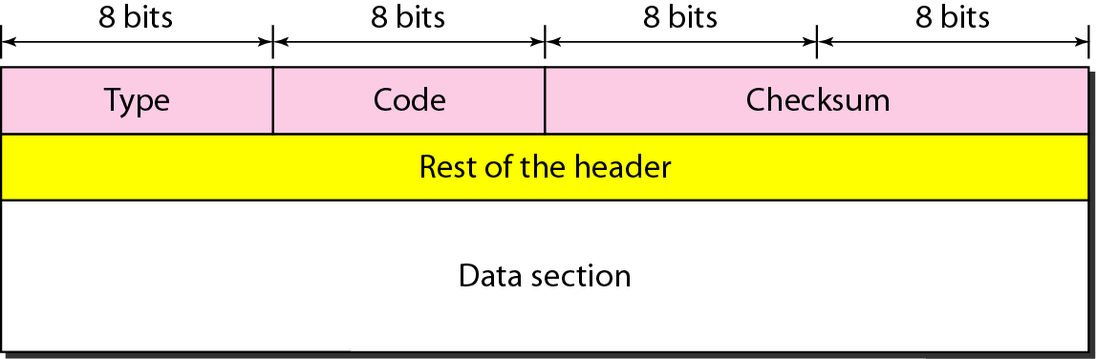
Figure General format of ICMP messages

Slide 58
Error reporting message
ICMP doesn’t correct errors it simply reports them. Error correction is left to the higher level protocols.
Destination unreachable
Source quench
Time exceeded
Parameter problems
redirection

Slide 59
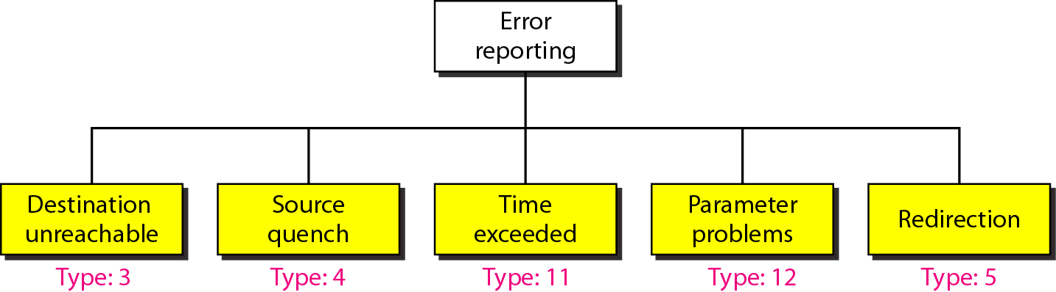
Figure Error-reporting messages

Slide 60
Error reporting message
Destination unreachable :When a router can’t route a datagram or a host can’t deliver a datagram, the datagram is discarded and the router/host sends a destination unreachable message back to the source host that initiated the datagram.
Source quench :No flow control mechanism in IP. May create congestion in routers. Router has limited size queue for incoming datagram. If the datagram are received much faster than they can be processed, overflow. Discard few datagram. Source quench message adds kind of flow control to the IP. When a router discards a datagram due to congestion, it sends a source quench message to the sender of the datagram. This message has two purposes.
It informs the source that datagram has been discarded.
It warns the source that there is a congestion somewhere in the path and source should slow down the sending process.

Slide 61
Error reporting message
Time exceeded: time exceeded message is generated in two cases.
Whenever a router receives a datagram with a time to live value of zero, it discards the datagram and sends time exceeded message to the sender.
When the final destination doesn’t receive all the fragments in a set time.
Parameter problem: if a router discovers an ambiguous or missing value in any field of the datagram, it discards the datagram and sends a parameter problem message back to the source.

Slide 62
Redirect: This type of message can only be initiated by a gateway.
However, in some circumstances, a host connects to a segment that has two or more directly connected routers.
In this case, the default gateway of the host may need to use a redirect/change request to inform the host of the best path to a certain network.
a host that wants to send data to a host on another network needs to know the address of routers connected to its own network.
Also, the host must know if the routers are alive and functioning.

Slide 63
Query message
Echo request and reply
Time stamp request and reply
Address mask request and reply

Slide 64
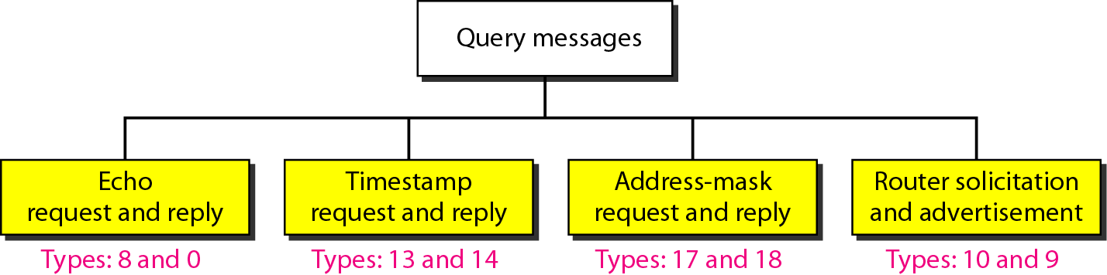
Figure Query messages

Slide 65
Are designed for diagnostic purposes. Used to identify network problems. It determines whether two systems can communicate with each other. PING COMMAND
2. Two machines can use the timestamp request and reply message to determine the sound-trip time needed for an IP datagram to travel between them. It is also used to synchronize the clocks in two machines.
3. IP address=network address + subnet address and host identifier. A host may know its full IP address, but it may not know which part of the address defines the net, subnet and host identifier. To obtain its mask, a host sends a address mask request message to a router on the LAN. The router receiving the address mask request message responds with an address mask reply message providing the necessary mask for the host. This can be applied to its full IP address to get its subnet address.

Slide 66
Reverse Address Resolution Protocol
The Reverse Address Resolution Protocol (RARP) allows a host to discover its Internet address when it knows only its physical address.
It is used when a computer is connected to a network for the first time or when a diskless computer is booted.

Slide 67
Transport Layer Protocols
TCP, UDP

Slide 68
Transport Layer
Traditionally the transport layer was represented in TCP/IP by two protocols: TCP and UDP.
IP is a host-to-host protocol, meaning that it can deliver a packet from one physical device to another.
UDP and TCP are transport level protocols responsible for delivery of a message from a process (running program) to another process.

Slide 69
Transport layer protocols
From user’s point of view, the TCP/IP-based internet can be considered as a set of application programs that use the internet to carry out useful communication tasks.
Most popular internet applications include Electronic mail, File transfer, and Remote login
IP allows transfer of IP datagrams among a number of stations or hosts, where the datagram is routed through the internet based on the IP address of the destination.

Slide 70
But, in this case, several application programs (processes) simultaneously running on a source host has to communicate with the corresponding processes running on a remote destination host through the internet.
This requires an additional mechanism called process-to-process delivery, which is implemented with the help of a transport-level protocol.
The transport level protocol will require an additional address, known as port number, to select a particular process among multiple processes running on the destination host. So, there is a requirement of the following third type of delivery system.

Slide 71
Process to process delivery
Data link layer: host to host delivery
Network layer: source to destination delivery
Communication on the Internet is not defined as the exchange of data between two nodes or between two hosts. Real communication takes place between two processes (application programs).
We need process-to-process delivery
The transport layer is responsible for process-to-process delivery-the delivery of a packet, part of a message, from one process to another.
Two processes communicate in a client/server relationship

Slide 72
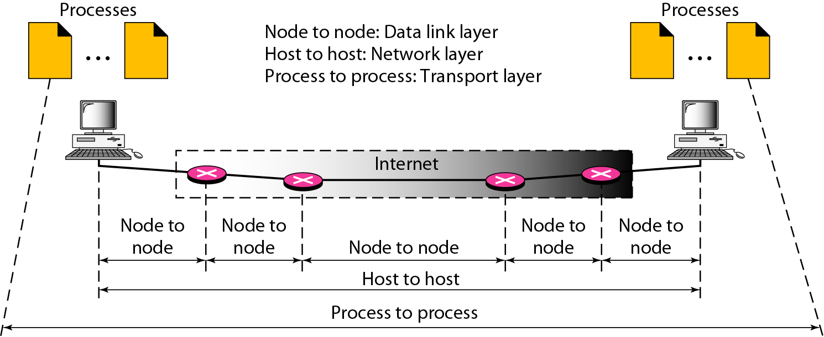
Figure Types of data deliveries

Slide 73
Addressing
Data link layer (MAC address), network layer (IP address) and at transport layer, we need transport address called PORT ADDRESS to choose among multiple processes running on destination host.
In the Internet model, the port numbers are 16-bit integers between 0 and 65,535.
Used by host to host protocol to identify to which higher level protocol or application program(process) it must deliver incoming messages.

Slide 74
Addressing
The lANA (Internet Assigned Number Authority) has divided the port numbers into three ranges: well known, registered, and dynamic
Well-known ports. The ports ranging from 0 to 1023 are assigned and controlled by lANA. These are the well-known ports.
Registered ports. The ports ranging from 1024 to 49,151 are not assigned or controlled by lANA. They can only be registered with lANA to prevent duplication.
Dynamic ports. The ports ranging from 49,152 to 65,535 are neither controlled nor registered. They can be used by any process. These are the ephemeral ports.

Slide 75
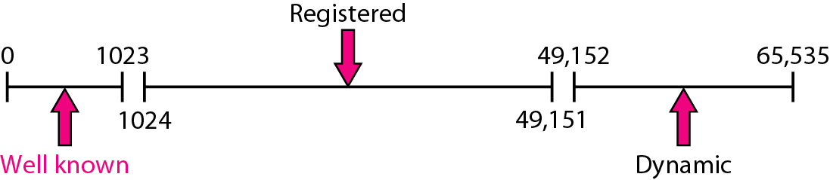
Figure IANA ranges

Slide 76
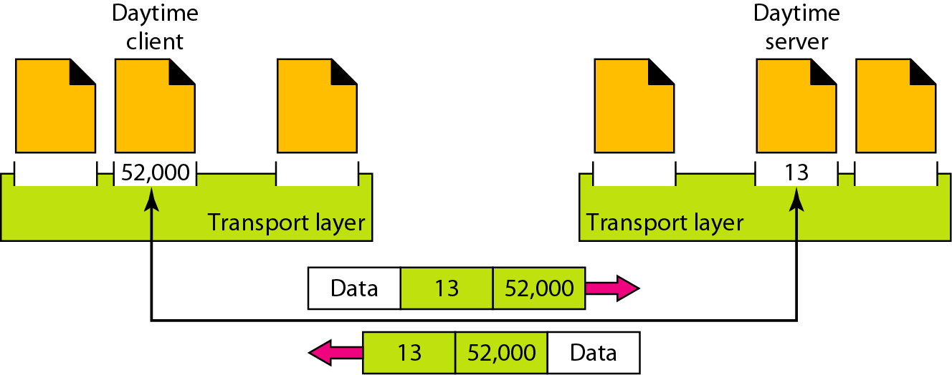
Figure Port numbers

Slide 77
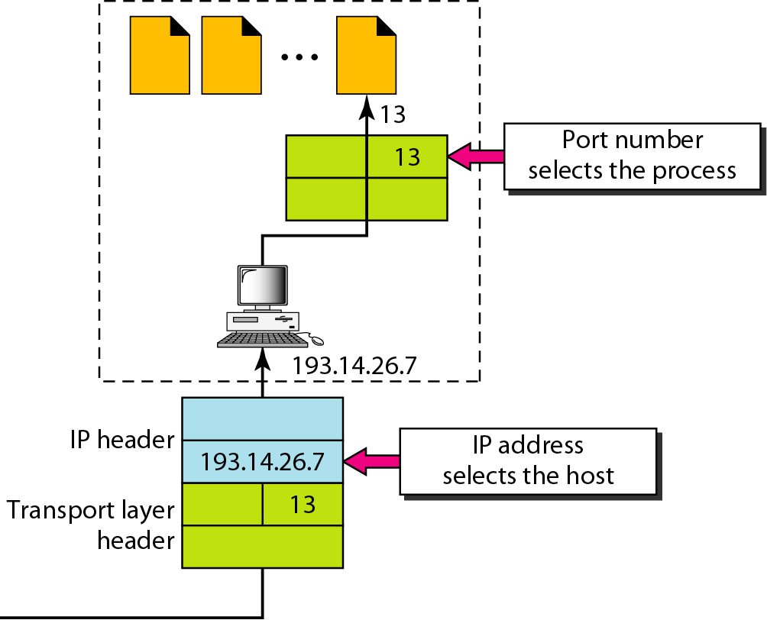
Figure IP addresses versus port numbers

Slide 78
SOCKET
Process-to-process delivery needs two identifiers, IP address and the port number, at each end to make a connection
The combination of an IP address and a port number is called a socket address
The client socket address defines the client process uniquely just as the server socket address defines the server process uniquely
A transport layer protocol needs a pair of socket addresses: the client socket address and the server socket address. These four pieces of information are part of the IP header and the transport layer protocol header.
The IP header contains the IP addresses; the UDP or TCP header contains the port numbers.

Slide 79
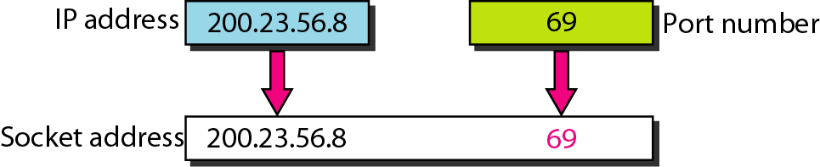
Figure Socket address

Slide 80
MUX and DEMUX
The addressing mechanism allows multiplexing and demultiplexing by the transport layer
At the sender site, there may be several processes that need to send packets. However, there is only one transport layer protocol at any time.
This is a many-to-one relationship and requires multiplexing
At the receiver site, the relationship is one-to-many and requires demultiplexing.
The transport layer receives datagrams from the network layer. After error checking and dropping of the header, the transport layer delivers each message to the appropriate process based on the port number.

Slide 81
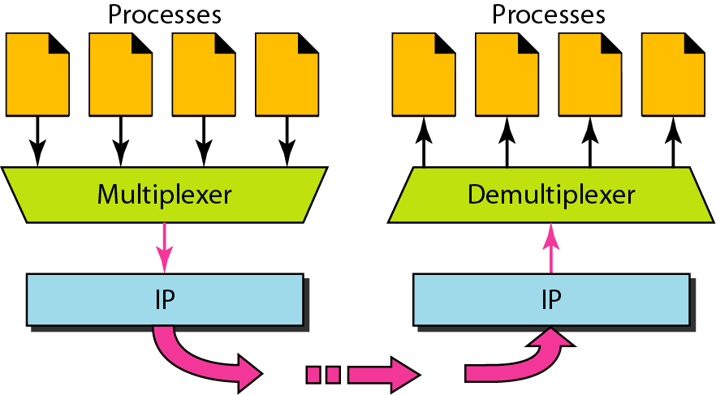
Figure Multiplexing and demultiplexing

Slide 82
Connectionless vs connectionoriented services
Connection less service
Connection oriented service
Connectionless
The packets are sent from one party to another with no need for connection establishment or connection release
The packets are not numbered; they may be delayed or lost or may arrive out of sequence.
There is no acknowledgment either
UDP
In a connection-oriented service, a connection is first established between the sender and the receiver.
Data are transferred.
At the end, the connection is released.
TCP and SCTP

Slide 83
Reliable vs unreliable services
Transport layer service may be reliable and unreliable
If application needs reliability, we use a reliable transport layer protocol by implementing flow and error control at the transport layer. This means a slower and more complex service.
In opposite case, unreliable protocols are used.
Connection oriented protocols are reliable and connection less protocols are unreliable.
Reliable : TCP and SCTP
Unreliable: UDP

Slide 84
UDP
Simple, unreliable transport layer protocol
Connectionless, unreliable transport protocol
It does not add anything to the services of IP except for providing process to process communication instead of host to host communication.
It performs very limited error checking
If a process wants to send a small message and doesn’t care much about reliability, it can use UDP
UDP is convenient protocol for multimedia and multicasting applications

Slide 85
UDP
UDP is responsible for differentiating among multiple source and destination processes within one host. Multiplexing and demultiplexing operations are performed using the port mechanism as

Slide 86
UDP-port numbers
UDP uses port numbers as the addressing mechanisam in the transport layer.
Well-known ports (0-1023)
Registered ports (1024-49151)
Dynamic ports (49152-65535)

Slide 87
Table Well-known ports used with UDP

Slide 88
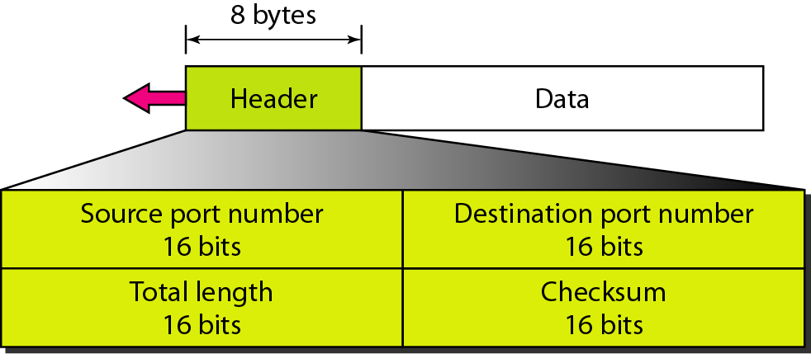
Figure User datagram format

Slide 89
USER DATAGRAM
UDP packets, called user datagram, have a fixed size header of 8 bytes. Figure shows the format of user datagram
Source port (16 bits): It defines the port number used by the process running on the source host. It can range from 0-65535
Destination port (16 bits): It defines the port number used by the process running on the destination .
Length: This is a 16 bit field that defines the total length of the user datagram, header plus data.
Checksum: It is used to detect errors over the entire user datagram. It ensures the integrity of data. It is optional. If not calculated, the field is filled with 0s.

Slide 90
Applications
UDP is suitable for a process that requires simple request response communication with little concern for flow and error control. It is not used for a process that needs to send bulk data, such as FTP.
Suitable for multicasting. Multicasting capabilities are embedded in the UDP software but not in the TCP software.
UDP is used for some route updating protocols such as routing information protocol (RIP)
UDP is used in conjunction with the real time transport protocol (RTP) to provide a transport layer mechanism for real time data.

Slide 91
TCP
TCP provides a connection-oriented, full-duplex, reliable, streamed delivery service using IP to transport messages between two processes.
It adds connection-oriented and reliability features to the services of IP
Reliability is ensured by:
Connection-oriented service
Flow control using sliding window protocol
Error detection using checksum
Error control using go-back-N ARQ technique
Congestion avoidance algorithms; multiplicative decrease and slow-start

Slide 92
SERVICES offered by TCP
Process to process communication
Like UDP, TCP provides process-to-process communication using port numbers. Table lists some well-known port numbers used by TCP

Slide 93
Table Well-known ports used by TCP

Slide 94
TCP Datagram
Source port (16 bits): It defines the port number of the application program in the host of the sender
Destination port (16 bits): It defines the port number of the application program in the host of the receiver
Sequence number (32 bits):
It conveys the receiving host which octet in this sequence comprises the first byte in the segment
Specifies position of transmitting data in original data stream
Acknowledgement number (32 bits): This specifies the sequence number of the next octet that receiver expects to receive
HLEN (4 bits): This field specifies the number of 32-bit words present in the TCP header

Slide 95
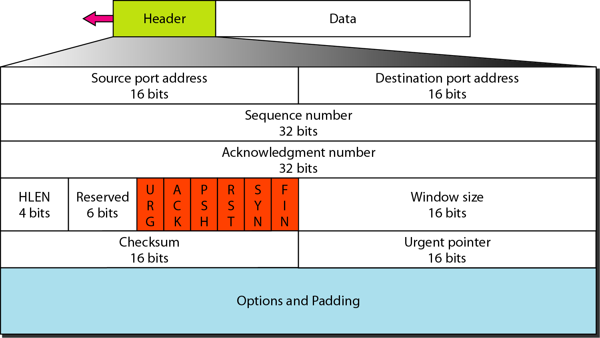
Figure TCP segment format

Slide 96
TCP Datagram: Control field
Control flag bits (6 bits):
URG: Indicates whether Urgent pointer field is valid
ACK: Indicates whether acknowledge field is valid
PSH: Push the data without buffering
RST: Resent the connection
SYN: Synchronize sequence numbers during connection establishment
FIN: Terminate the connection

Slide 97
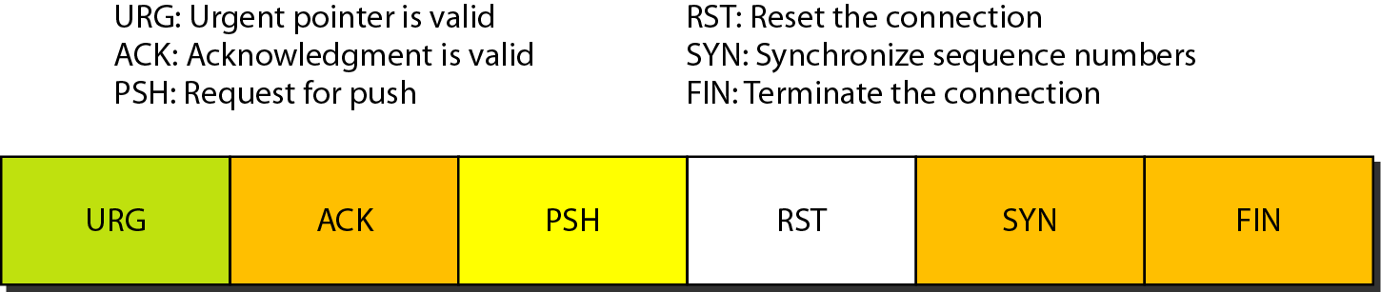
Figure Control field

Slide 98
Table Description of flags in the control field

Slide 99
Window size. This field defines the size of the window, in bytes, that the other party must maintain.
Note that the length of this field is 16 bits, which means that the maximum size of the window is 65,535 bytes.
Checksum. This 16-bit field contains the checksum. Checksum used for error detection.
Urgent pointer. This l6-bit field, which is valid only if the urgent flag is set, is used when the segment contains urgent data. It defines the number that must be added to the sequence number to obtain the number of the last urgent byte in the data section of the segment.
Options. There can be up to 40 bytes of optional information in the TCP header

Slide 100
TCP services
Full duplex communication
Connection oriented services
TCP offers full-duplex service, in which data can flow in both directions at the same time
Reliable services
TCP is a reliable transport protocol. It uses an acknowledgment mechanism to check the safe and sound arrival of data
TCP, unlike UDP, is a connection-oriented protocol. When a process at site A wants to send and receive data from another process at site B, the following occurs:
The two TCPs establish a connection between them.
Data are exchanged in both directions.
The connection is terminated.

Slide 101
TCP VS UDP
Reliability: TCP is connection-oriented protocol. When a file or message send it will get delivered unless connections fails. If connection lost, the server will request the lost part. There is no corruption while transferring a message.
Ordered: If you send two messages along a connection, one after the other, you know the first message will get there first. You don't have to worry about data arriving in the wrong order
Reliability: UDP is connectionless protocol. When you a send a data or message, you don't know if it'll get there, it could get lost on the way. There may be corruption while transferring a message
Ordered: If you send two messages out, you don't know what order they'll arrive in i.e. no ordered

Slide 102
TCP VS UDP
3.Streaming: Data is read as a "stream," with nothing distinguishing where one packet ends and another begins. There may be multiple packets per read call
4.Examples: World Wide Web (Apache TCP port 80), e-mail (SMTP TCP port 25 Postfix MTA), File Transfer Protocol (FTP port 21) and Secure Shell (OpenSSH port 22) etc
3.Datagrams: Packets are sent individually and are guaranteed to be whole if they arrive. One packet per one read call
4.Examples: Domain Name System (DNS UDP port 53), streaming media applications such as IPTV or movies, Voice over IP (VoIP), Trivial File Transfer Protocol (TFTP) and online multiplayer games etc

